Slide 1

Working with Assistants Part 8: More Working with Runs

Slide 2
Lewis Black
“It's a big thing now: A lot of people want to be assistants to celebrities. If you're pursuing that, you're an idiot. You're a moron. The shortest distance between two points is not a celebrity, or being next to a celebrity.”

Slide 3



Notes:
https://www.youtube.com/channel/UC35ZpwldGw7ZJ5R-2sLijzw

Slide 4

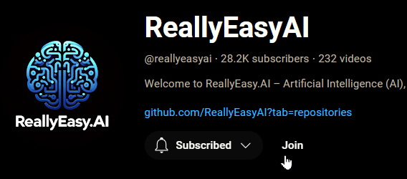
Membership has its privileges
Notes:
https://www.youtube.com/channel/UC35ZpwldGw7ZJ5R-2sLijzw/join

Slide 5
Getting Output
What is the Response from the Model?

Slide 6
Demo: Getting the Output from the Model
# Retrieve messages from the thread
messages = client.beta.threads.messages.list(thread_id=thread.id)
# Get the latest assistant message
latest_assistant_message = None
for message in messages.data:
if message.role == 'assistant' and message.run_id == fresh_run.id:
latest_assistant_message = message
break
# Print the latest response
if latest_assistant_message:
print("Output:\n" + latest_assistant_message.content[0].text.value)
else:
print("No assistant message found for the run.")

Slide 7
Demo: Streaming Output
# First, we create a EventHandler class to define
# how we want to handle the events in the response stream.
class EventHandler(AssistantEventHandler):
@override
def on_text_created(self, text) -> None:
print(f"\nassistant text > ", end="", flush=True)
@override
def on_text_delta(self, delta, snapshot):
print(delta.value, end="", flush=True)
def on_tool_call_created(self, tool_call):
print(f"\nassistant tool > {tool_call.type}\n", flush=True)
def on_tool_call_delta(self, delta, snapshot):
if delta.type == 'code_interpreter':
if delta.code_interpreter.input:
print(delta.code_interpreter.input, end="", flush=True)
if delta.code_interpreter.outputs:
print(f"\n\noutput >", flush=True)
for output in delta.code_interpreter.outputs:
if output.type == "logs":
print(f"\n{output.logs}", flush=True)

Slide 8
Run Modifications
Temporarily Modifying Settings for Assistants and Threads

Slide 9
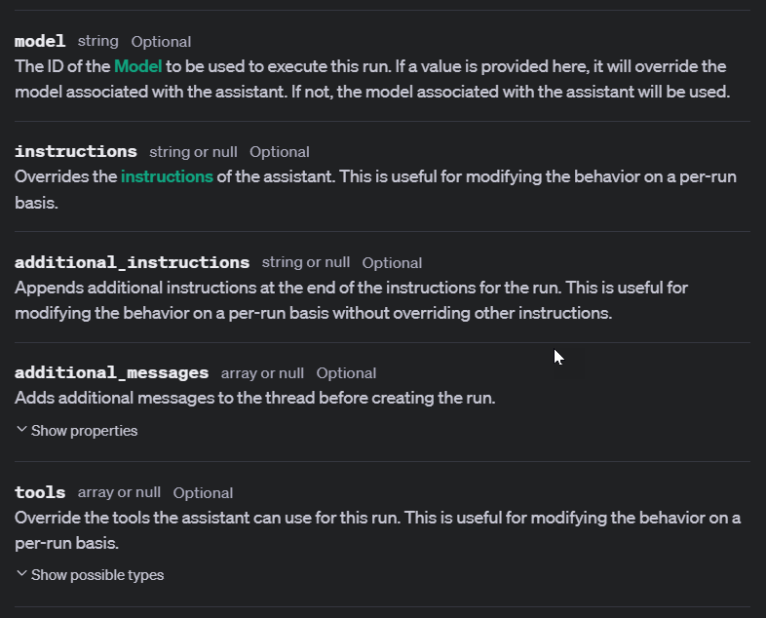
Notes:
https://platform.openai.com/docs/api-reference/runs/createRun

Slide 10
Demo: Modifying Assistants and Threads with Runs
# Create a run to add to modify Assistant instructions
additional_instruction_run = client.beta.threads.runs.create_and_poll(
assistant_id=assistant.id,
thread_id=thread.id,
additional_instructions="That speaks like a pirate.",
)

Slide 11
Controlling Output
Set Your Creativity Free!

Slide 12
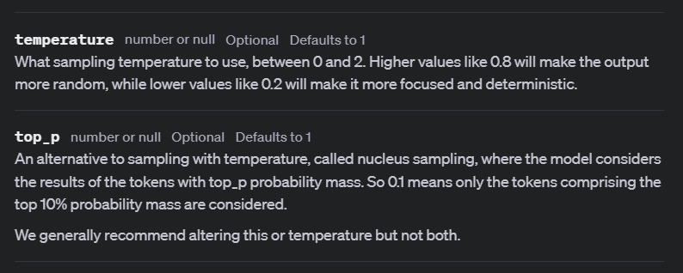

Slide 13
Demo: Run Temperature and Top_P
with client.beta.threads.runs.stream(
thread_id=thread.id,
assistant_id=assistant.id,
additional_messages=[
{
"role": "user",
"content": "Write a story about a magical frog in a forest in 100 words less."
}
],
temperature=0,
top_p=0.5,
event_handler=EventHandler(),
) as stream:
stream.until_done()

Slide 14


